Slide 1
Enodo TASK 1
TEAM KCM
Members= Kanaad D S(leader)
Chinmaya Ganapathi hedge
Madhuprakash t p
NMIT,Bangalore.

Slide 2
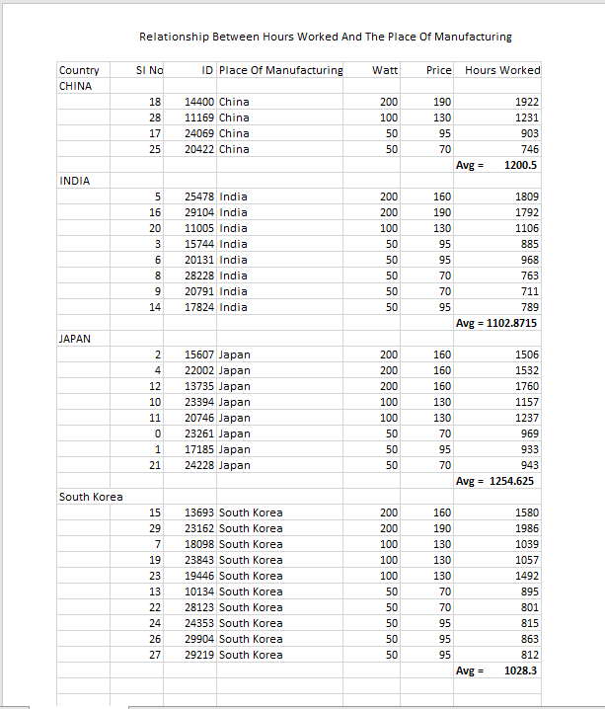
1. The relationship between hours worked and the Place Of Manufacturing.

Slide 3
By considering, average of hours THE BULB WORKED IN DIFFEREENT PLACES we can have bar graph FROM THE ABOVE TABLE.
From the above graph we can easily conclude that
YES ,there is relationship btwn hours worked & the place of manufacture
As average of hours worked by the bulb is high in some places whereas in some other places less.

Slide 4
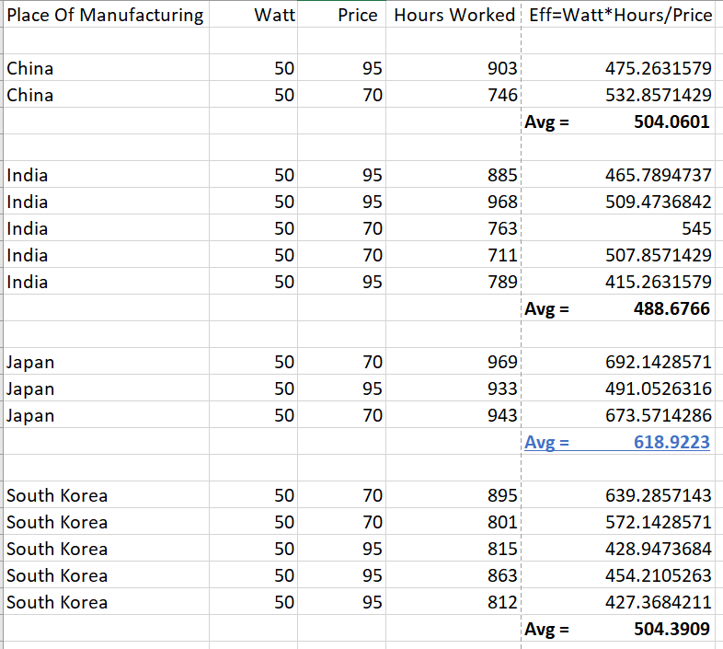
2.Preferred place of Manufacturing bulbs if we wish to buy 50 watt bulb.

Slide 5
By considering, EFFICENCY OF 50 WATT BULBS IN DIFFEREENT PLACES we can have bar graph FROM THE ABOVE TABLE.
By calculating efficiency as (EFFIENCY = (WATT * HOURS) / PRICE) for 50 watt bulbs manufactured
in different places and taking average of it we could see that from the above graph that bulbs of 50 watt produced in JAPAN has high average efficiency.
HENCE JAPAN SHOULD BE PREFERRED FOR PURCHASING 50 WATT BULBS.

Slide 6
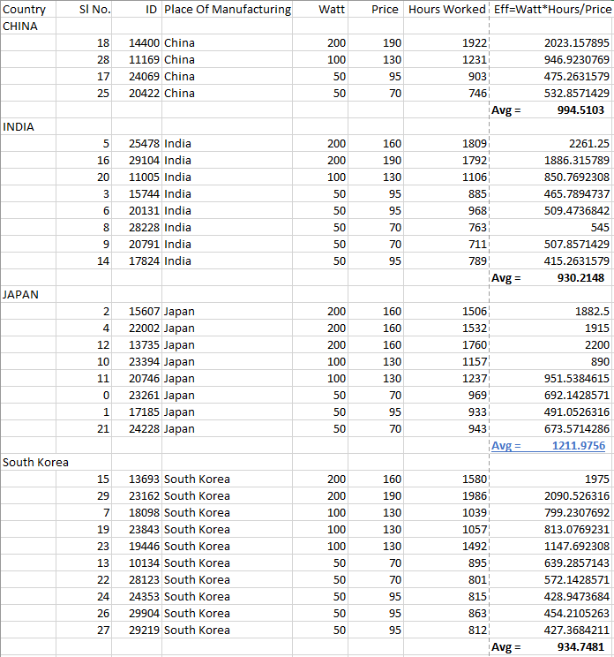
3.Country which provide maximum price to quality efficiency.

Slide 7
By considering, EFFICENCY OF BULBS IN DIFFEREENT PLACES we can have bar graph FROM THE ABOVE TABLE.
By calculating efficiency as (EFFIENCY = (WATT * HOURS) / PRICE) for bulbs manufactured in different places and taking average of it
we could see that from the above graph that bulbs manufactured in JAPAN have high average efficiency.
HENCE JAPAN PROVIDES HIGH PRICE TO QUALITY EFFICIENCY.

Slide 8
THANK YOU
TEAM KCM

